Slide 1

This practical class needs to be divided into groups, please make a group of 1~3 people.
https://www.shutterstock.com/zh-Hant/image-vector/icon-people-vector-727689157

Slide 2
Natural Language Processing
(NLP)
Presenter: Yan-Min Lu (呂彥旻)

Slide 3
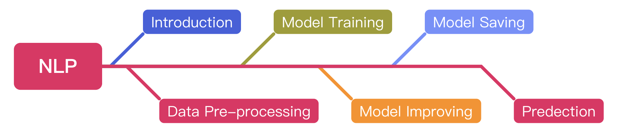
Outline

Slide 4
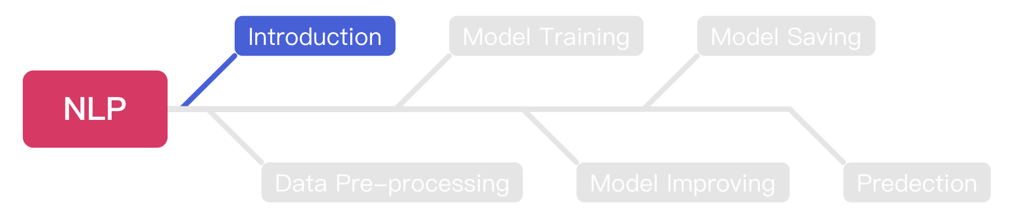
Outline

Slide 5
Machine Learning & Deep Learning
Artificial
Intelligence
Machine
Learning
Deep
Learning
https://assets.website-files.com/5fb24a974499e90dae242d98/5fb24a974499e96f7b2431db_AI%20venn%20diagram.png

Slide 6
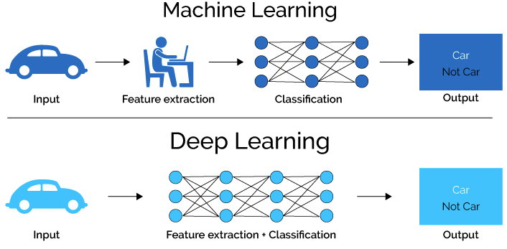
Machine Learning & Deep Learning (Cont’d)
https://medium.com/ai-academy-taiwan/%E7%82%BA%E4%BB%80%E9%BA%BC%E6%A8%A1%E5%9E%8B%E6%9C%83%E9%80%99%E6%A8%A3%E8%AA%8D%E7%82%BA-%E8%A7%A3%E9%87%8B%E7%9A%84%E6%B7%B1%E5%BA%A6%E5%AD%B8%E7%BF%92%E6%96%B9%E6%B3%95%E7%9A%84%E4%BB%8B%E7%B4%B9-%E8%A6%96%E8%A6%BA%E5%8C%96%E7%AF%87-1ac69c627483

Slide 7
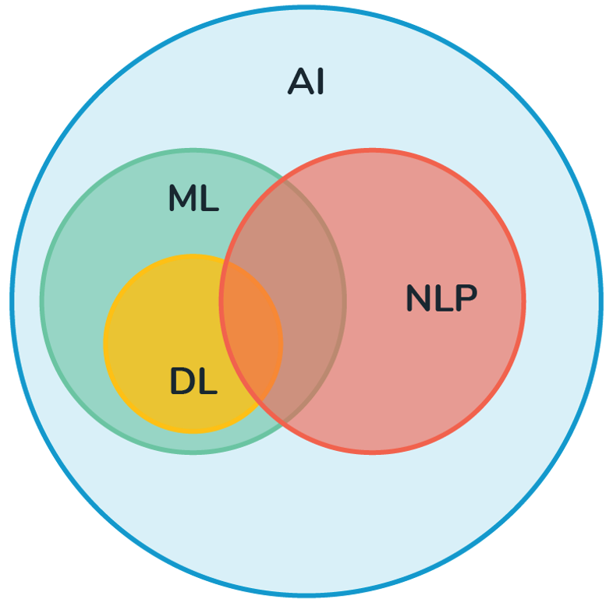
Natural Language Processing (NLP)
NLP is a subfield of AI.
The main idea of NLP is to make computers understand the human language such as English or Mandarin.
NLP can be applied on such as Siri or Google Assistant.
https://medium.com/@derekliao_62575/%E8%87%AA%E7%84%B6%E8%AA%9E%E8%A8%80%E8%99%95%E7%90%86nlp%E5%88%B0%E5%BA%95%E6%98%AF%E4%BB%80%E9%BA%BC-e29ab6356f6d

Slide 8
Machine Learning Methods
There are two main machine learning methods which are supervised learning and unsupervised learning.
Supervised learning: train the machine with the datasets which are labeled.
Unsupervised learning: train the machine with the datasets which are unlabeled.
Supervised Learning
Machine Learning
Unsupervised Learning
https://www.geeksforgeeks.org/ml-types-learning-supervised-learning/ https://www.researchgate.net/figure/Supervised-Learning-versus-Unsupervised-Learning-Mathworks-nd_fig1_319937079

Slide 9
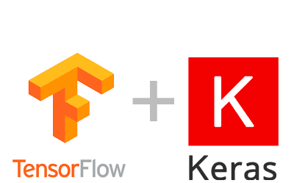
TensorFlow and Keras
TensorFlow: an end-to-end open source platform for machine learning & deep learning.
Keras: an effective high-level neural network (NN) application programming interface (API) in Python.
The Keras functions provide users to create and train a NN model easier.
https://dsalearning.github.io/tf.keras/2-2-tf-keras-python-dl-env/
https://www.tensorflow.org/overview

Slide 10

Google Colab
Before we start coding, we should know how to use Colab.
Colab allows you can write & run python code online.
Colab provides free GPU resource for ML model training.
https://clay-atlas.com/blog/2019/09/29/colab-chinese-tutorial/

Slide 11
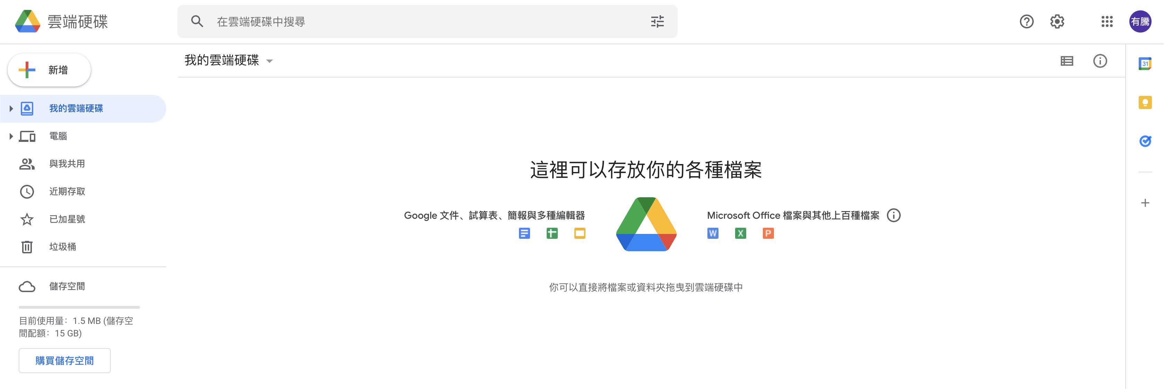
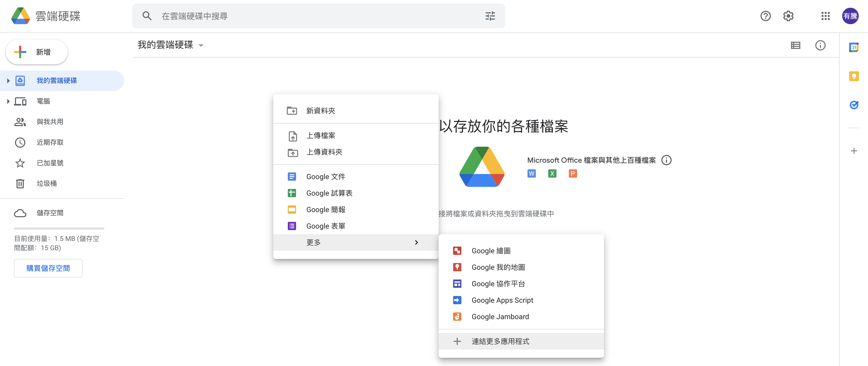
Connect Colab into Google Drive
We should connect Colab into google drive before we use it.
Right Click

Slide 12
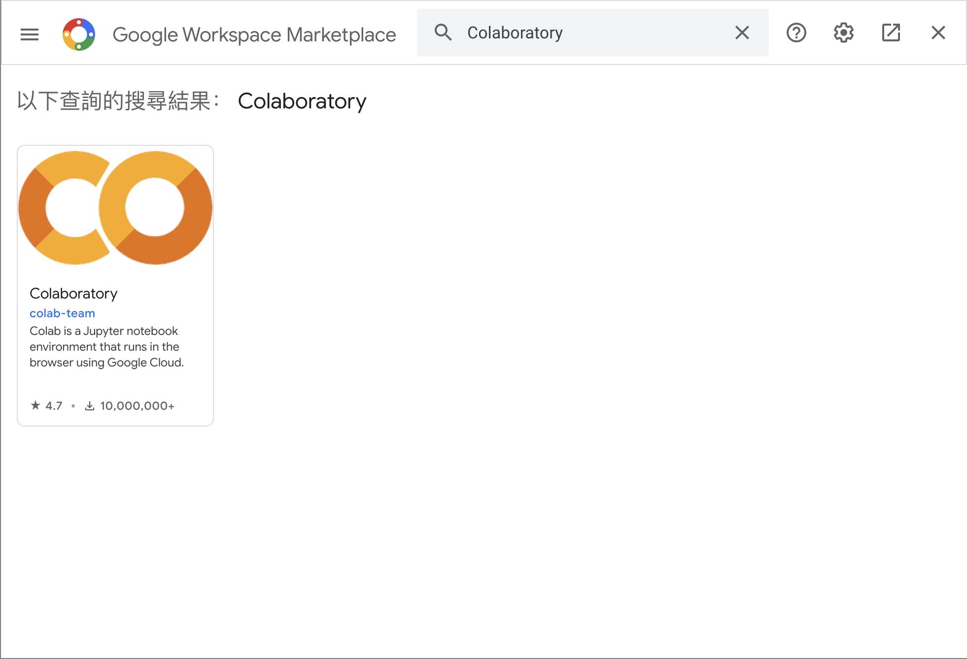
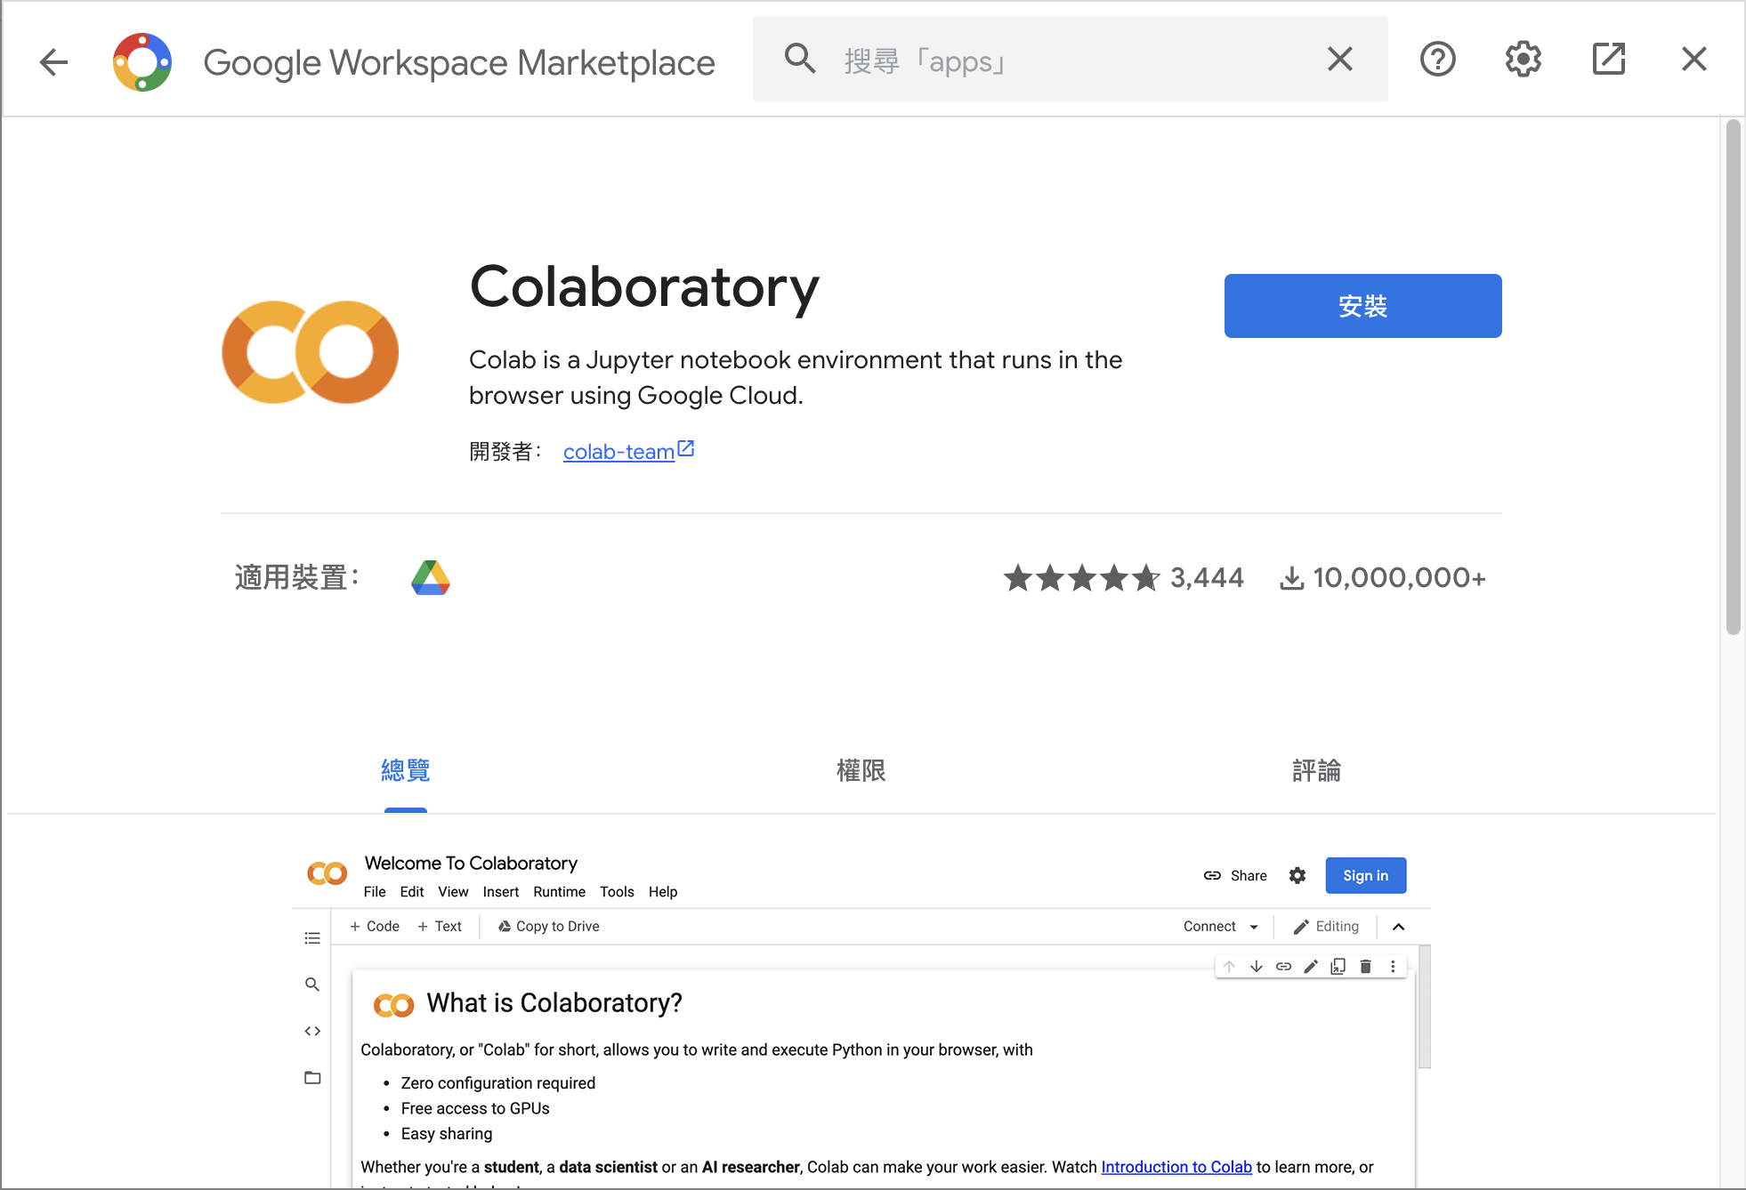
Connect Colab into Google Drive (Cont’d )
Search Colab and install it.

Slide 13
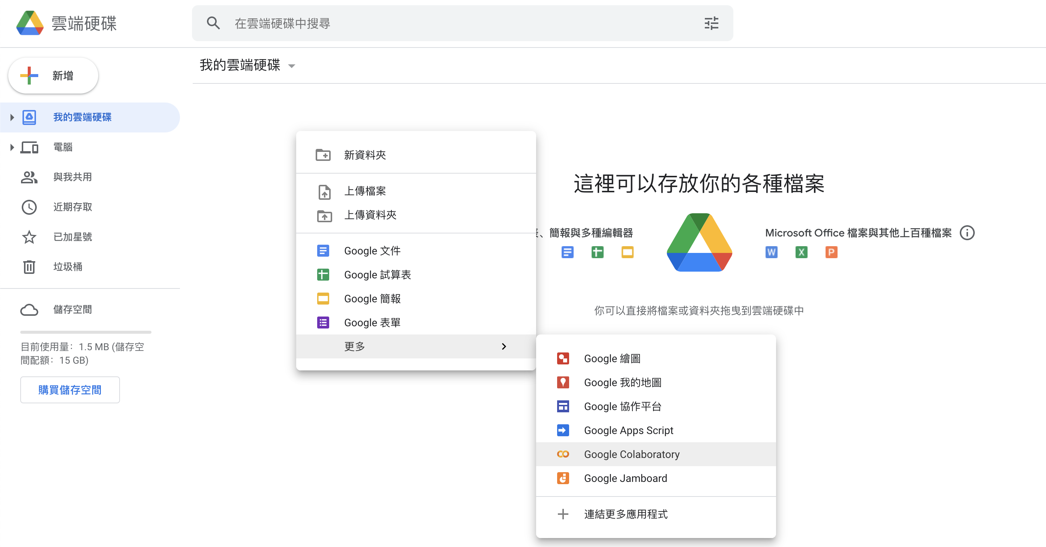
Connect Colab into Google Drive (Cont’d )
After installation, you can create a new Colab notebook.

Slide 14
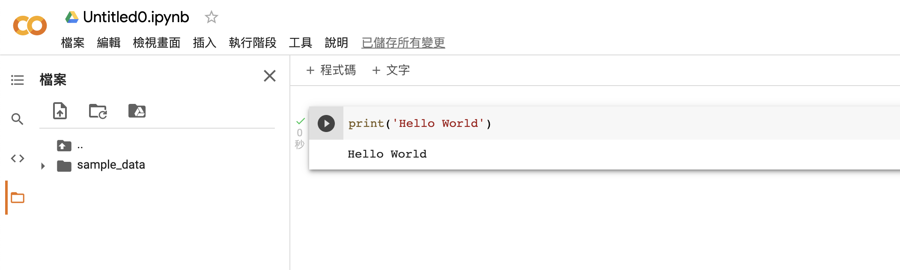
Colab User Interface (UI)
Notebook name
Python code
Code cell
Files
Output
Execute button

Slide 15
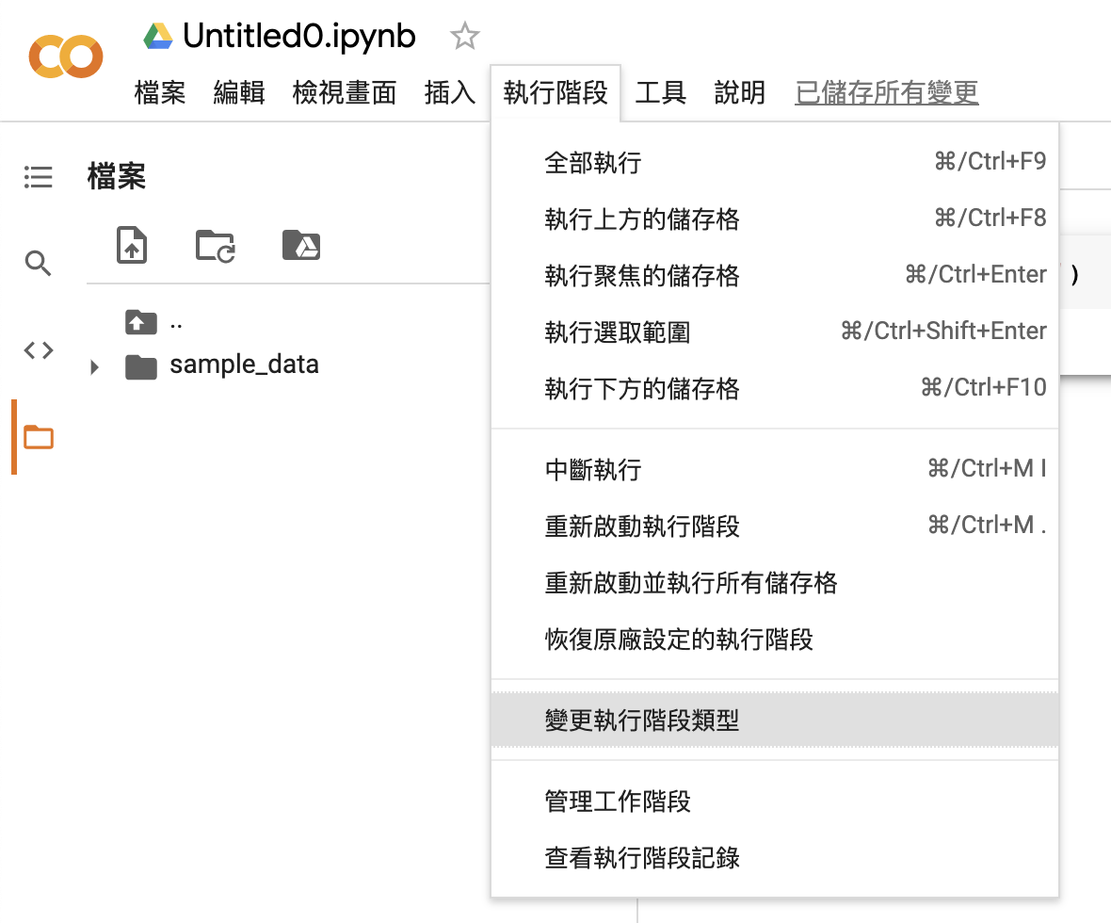
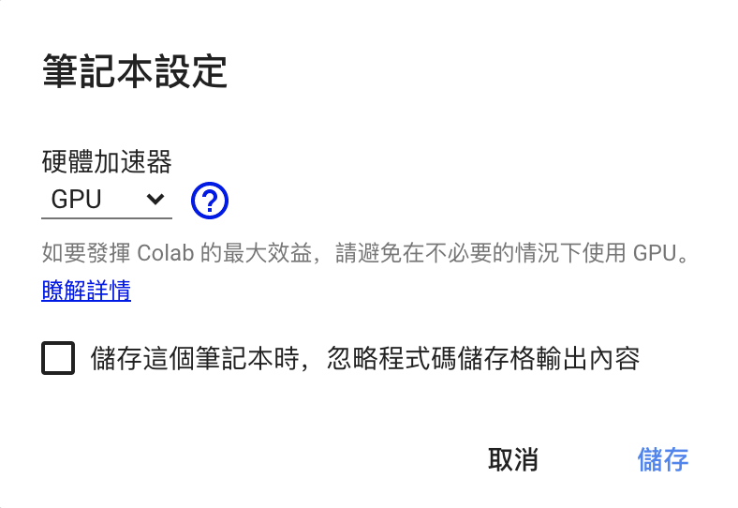
Change to Use GPU
We can change to GPU hardware accelerator.

Slide 16
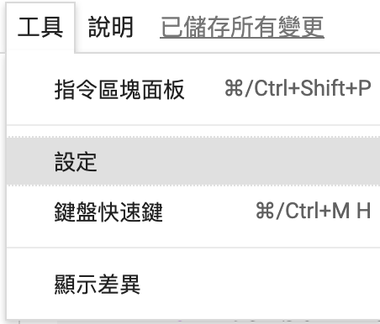
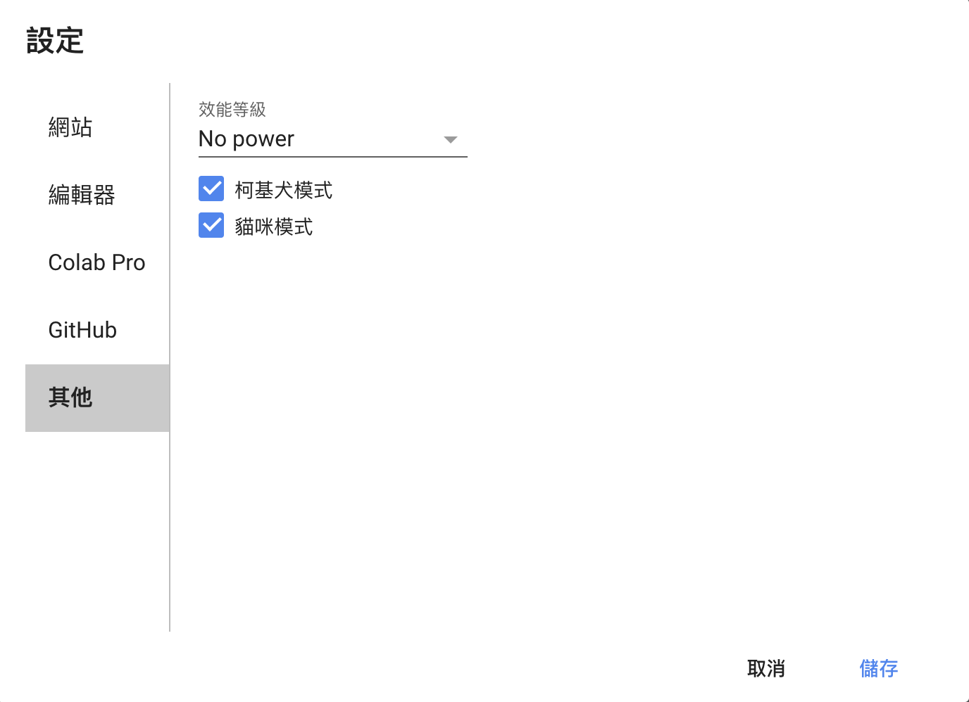
Open Cats and Corgis Mode
Please follow the steps to open cats and corgis mode, which can make you happy during coding.

Slide 17
Open Cats and Corgis Mode (Cont’d)
When you open the mode, you will see there are cats and corgis on your screen.
That’s the most important function of Google Colab.

Slide 18
TensorFlow Dataset (TFDS)
A ready-to-use datasets with TensorFlow based on Python.
Install TFDS with pip.
!pip install tensorflow_datasets
https://www.tensorflow.org/datasets/api_docs/python/tfds

Slide 19
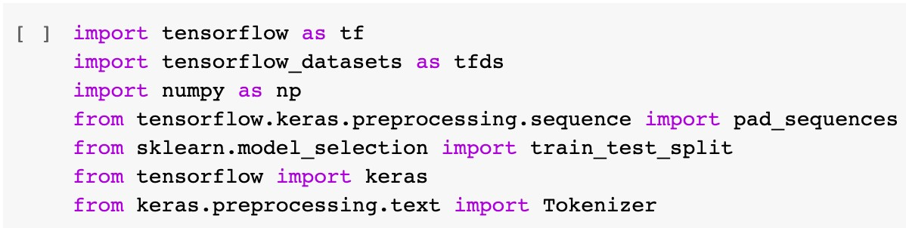
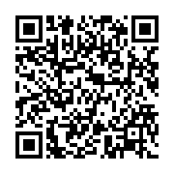
Import Packages
https://joyous-piper-08d.notion.site/Questions-50bb7522446d460683b195c8d20a68ef

Slide 20


Sarcasm Detection
Sarcasm detection model will be built as our example, which can classify whether the input sentence is sarcasm or not.
We will complete this experiment with TensorFlow and Keras.
https://www.wyo.in/pub/media/mf_webp/png/media/catalog/tmp/category/Sarcasm.webp https://forum.quartertothree.com/t/race-realism-its-toxic-racist-crap-lets-discuss-why/140953?page=14

Slide 21
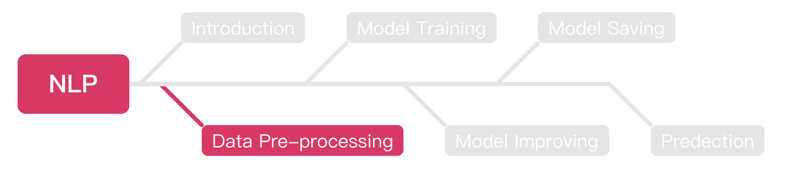
Outline

Slide 22
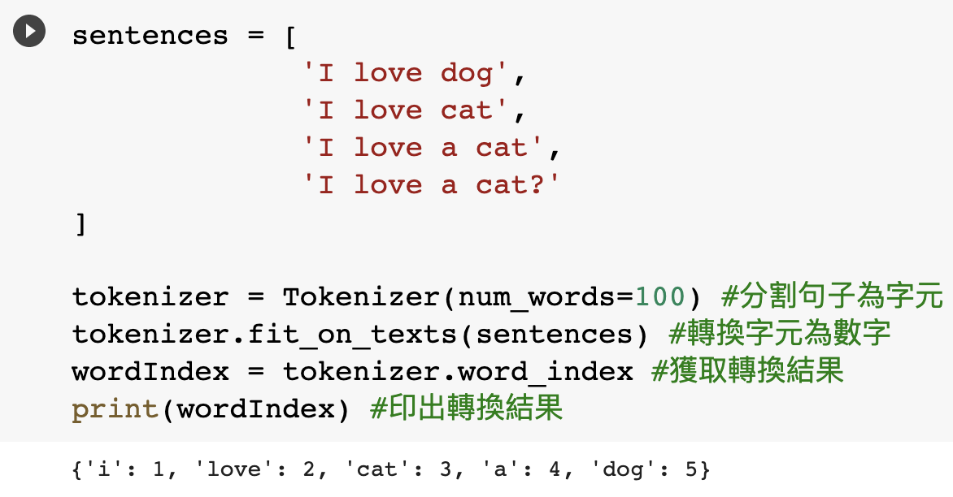
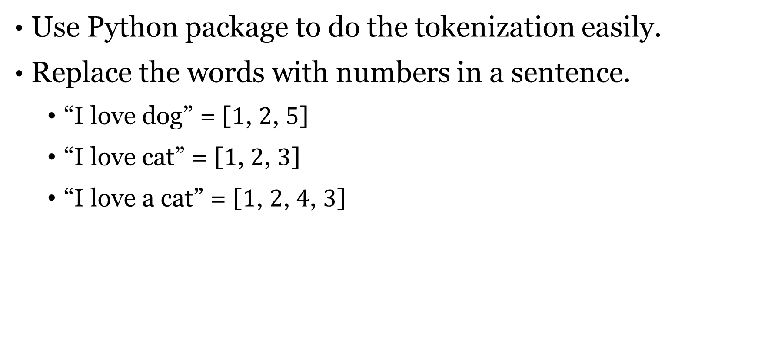
Tokenization
Use Python package to do the tokenization easily.
Replace the words with numbers in a sentence.
“I love dog” = [$1$, $2$, $5$]
“I love cat” = [$1$, $2$, $3$]
“I love a cat” = [$1$, $2$, $4$, $3$]
https://joyous-piper-08d.notion.site/Questions-50bb7522446d460683b195c8d20a68ef

Slide 23
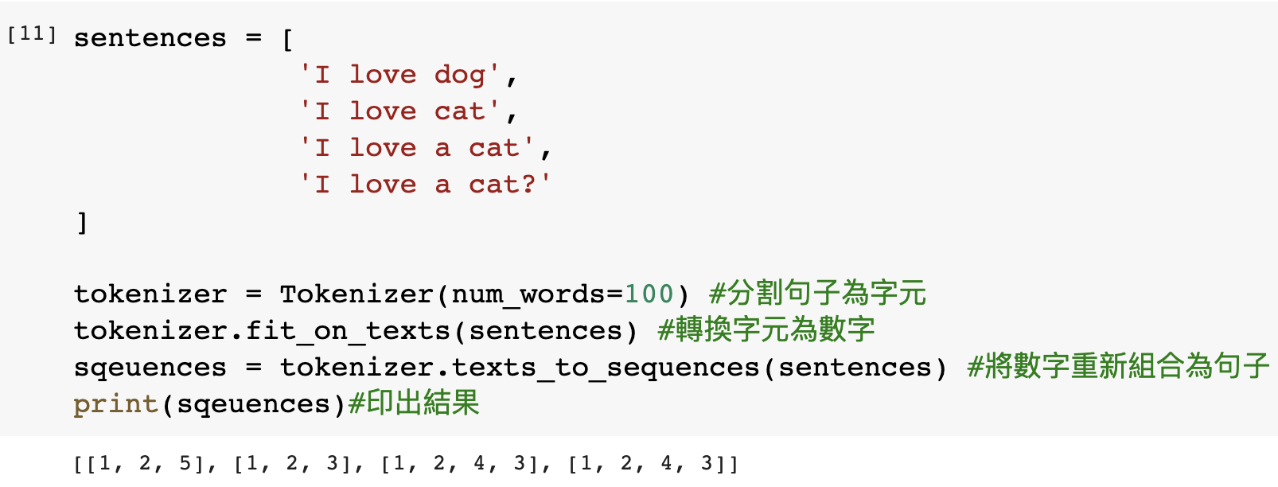
Texts to Sequences
Combine the indexes with the sentences.

Slide 24
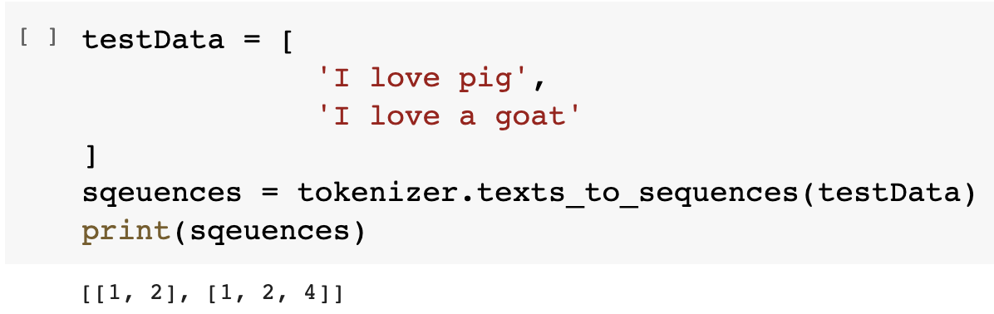
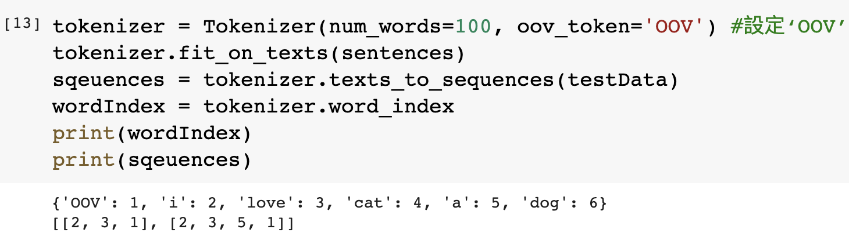
Out of Vocabulary (OOV)
The OOV is the word which your algorithm cannot recognize the word, so it means this word is not in the dataset.

Slide 25
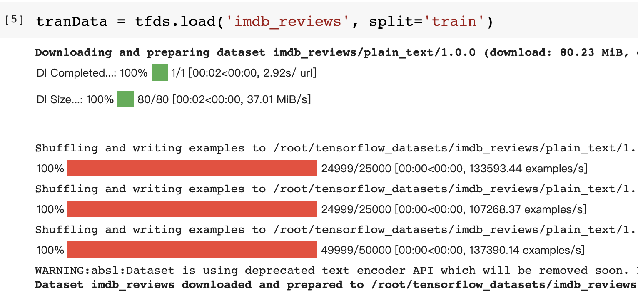
Get Texts from TensorFlow
Get the texts from TensorFlow.
https://joyous-piper-08d.notion.site/Questions-50bb7522446d460683b195c8d20a68ef

Slide 26
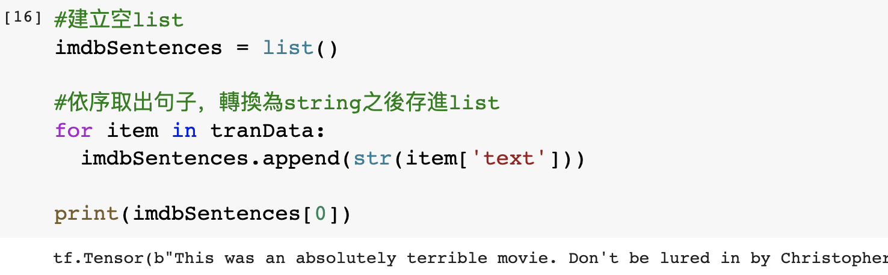
Get Texts from TensorFlow (Cont’d)
After loading dataset, each sentence is appended to a list.
Try to print the first data.

Slide 27
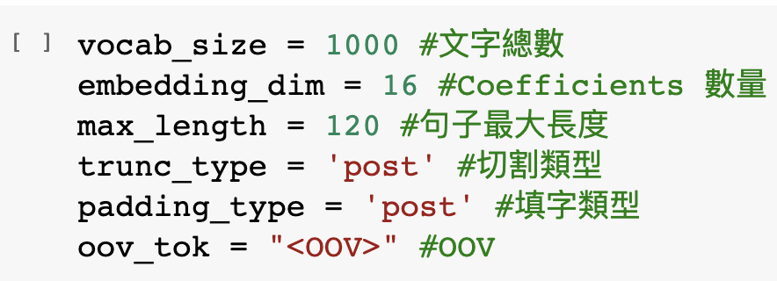
Parameters Declaration
These parameters will be use during our model train part, you can try to set it to different value and observe the differences.

Slide 28
Sarcasm Dataset
From now on, we will start to build a model for sarcasm detection.
We should do data pre-processing before to build a ML model.
Basically, the datasets will be provided in .json or .csv file format.
The format of example dataset is .json, but practice dataset will be .csv, please try to practice how to load these two different file formats.

Slide 29
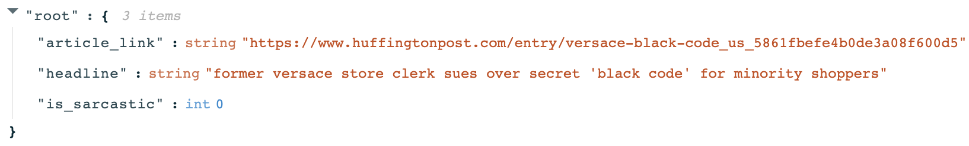
Sarcasm Dataset (Cont’d)
The following is the format of the sarcasm dataset as .json file, you should load and categorize all data as well.

Slide 30
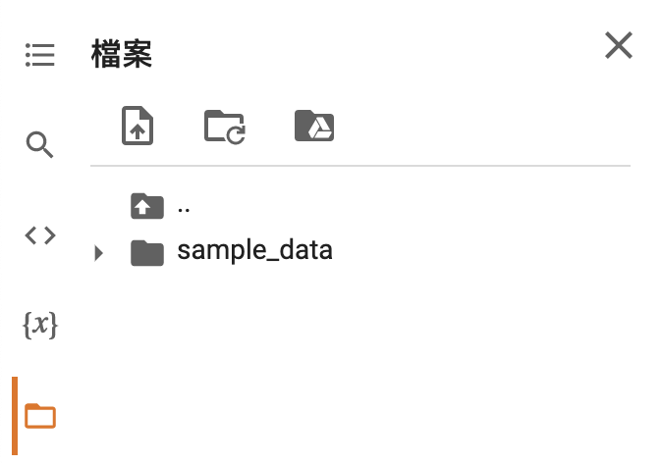
Upload File to Colab

Slide 31
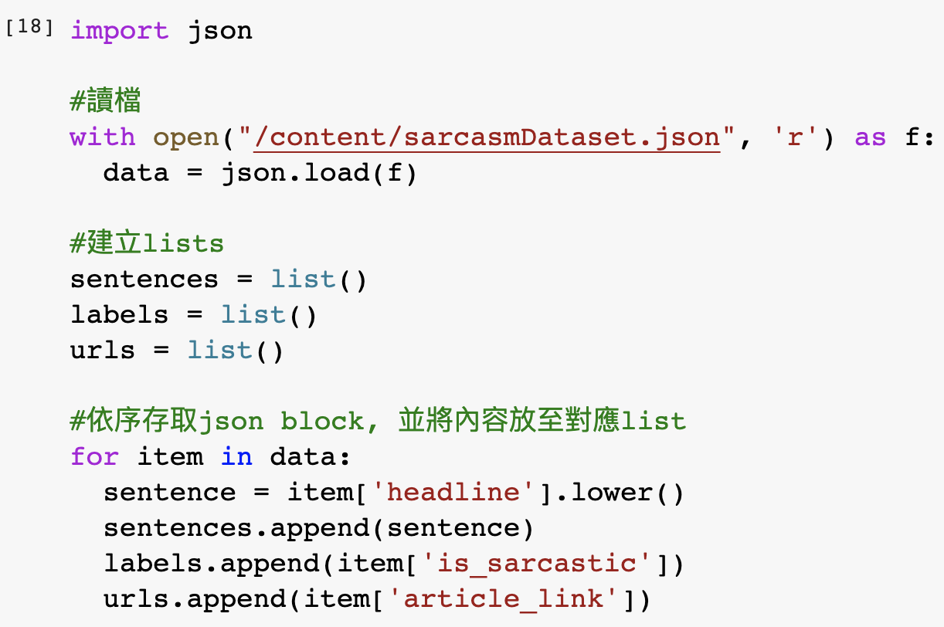
Load Data from .json File
The following is the process of loading dataset from .json file.

Slide 32
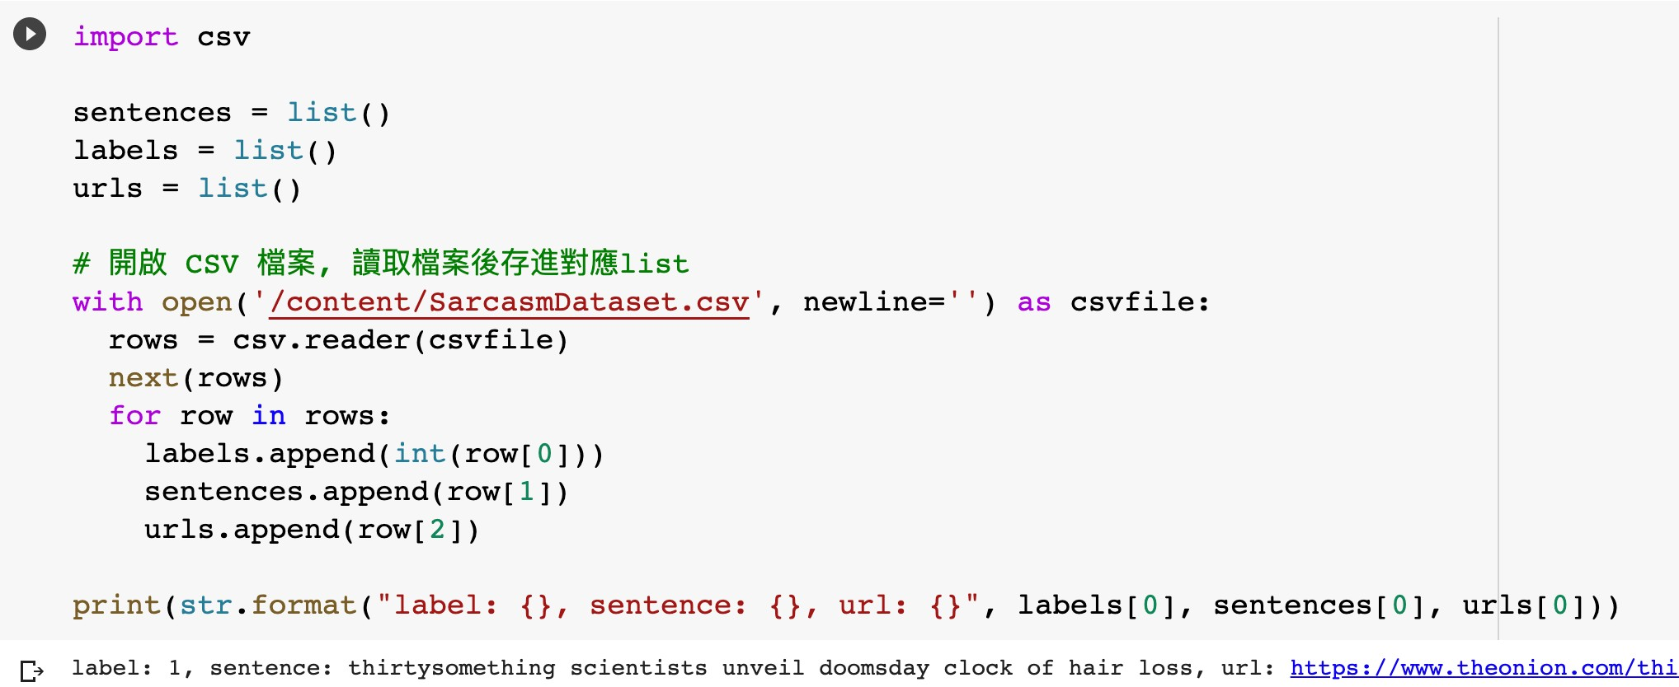
Load Data from .csv File
You can load the data from .csv file with these steps.

Slide 33
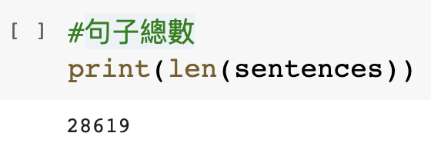
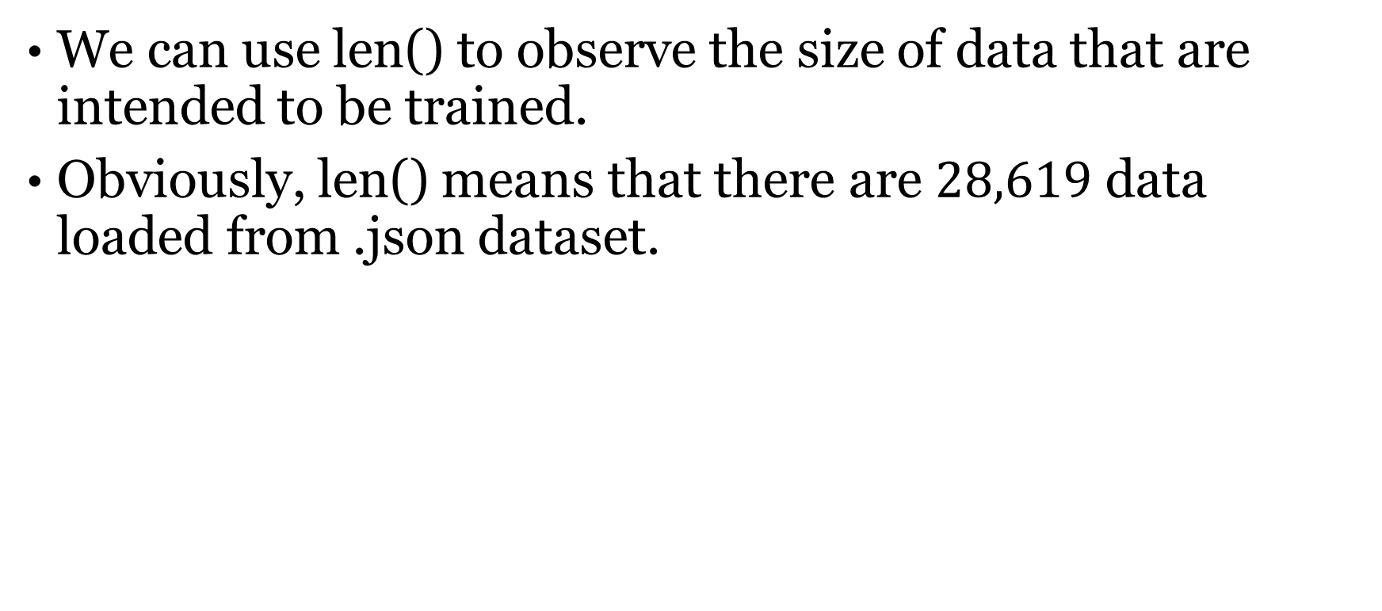
Amounts of Data
We can use len() to observe the size of data that are intended to be trained.
Obviously, len() means that there are $28,619$ data loaded from .json dataset.

Slide 34
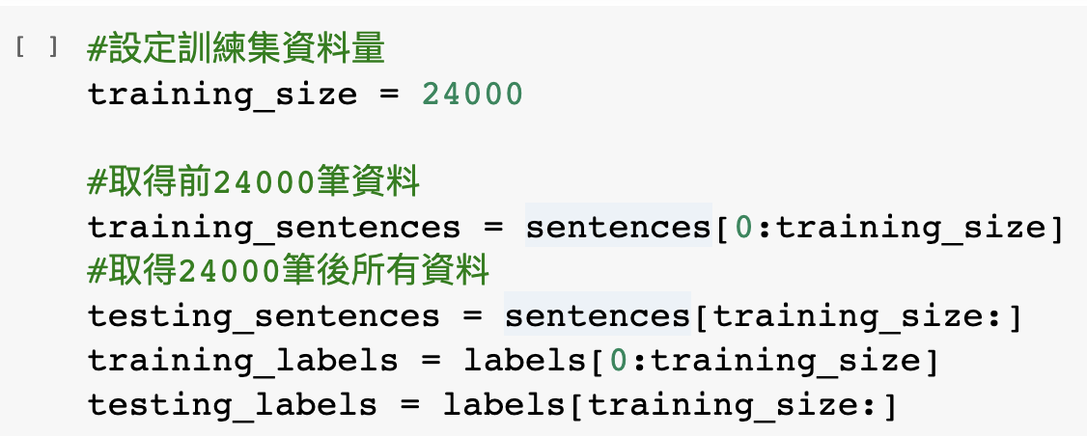
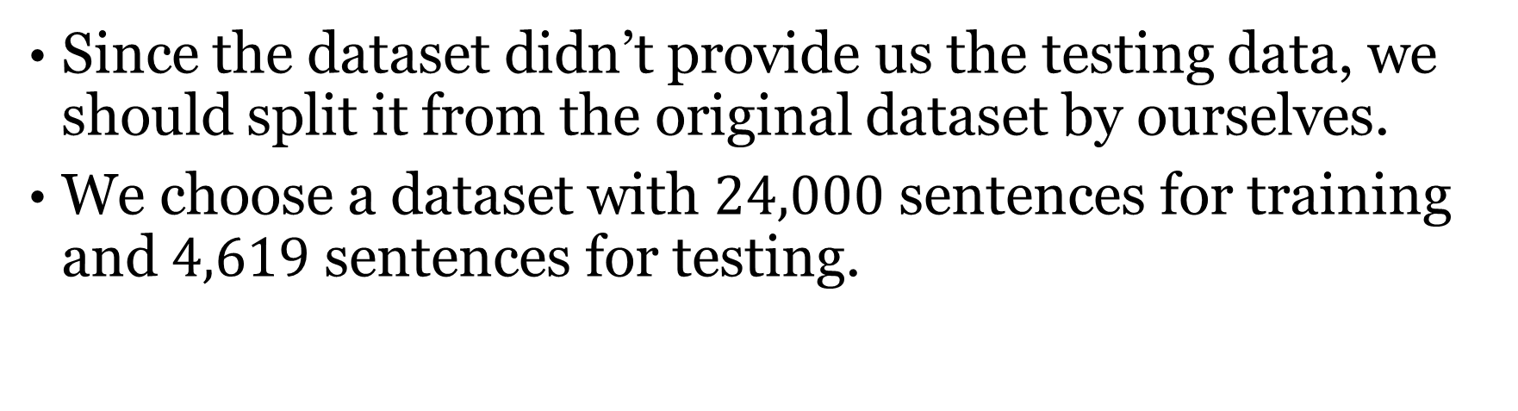
Split Dataset into Training and Testing
Since the dataset didn’t provide us the testing data, we should split it from the original dataset by ourselves.
We choose a dataset with $24,000$ sentences for training and $4,619$ sentences for testing.

Slide 35
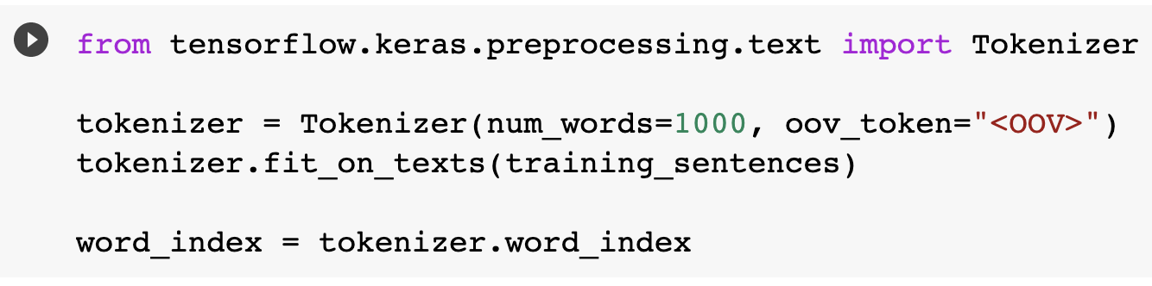
Tokenizer the Data
We should transfer our data from NLP to the word index before training.
We can use fit_on_texts() to transfer it easily.

Slide 36
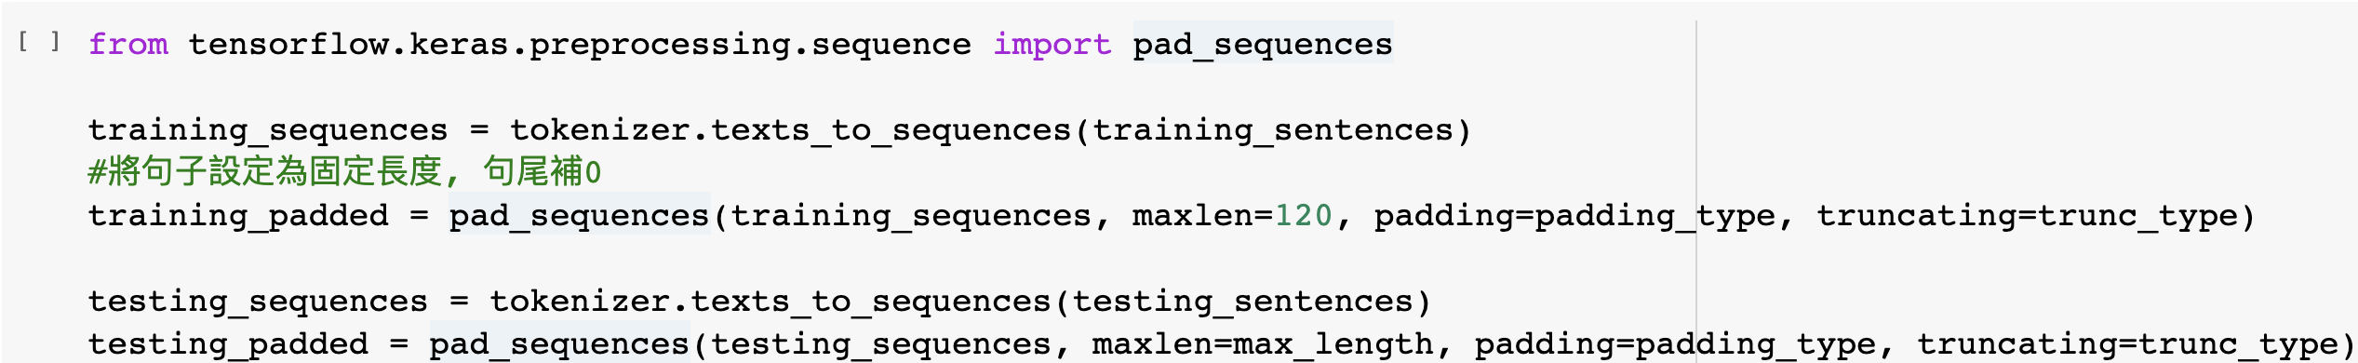
Sequences Pad
We should do sequences padding after tokenization.
The main idea is to make sure all data have the same length.
TensorFlow provides a simple method which is pad_sqeuences() to implement sequences padding.
1 2 3 4 5 6
1 3 4 0 0 0
2 5 0 0 0 0

Slide 37
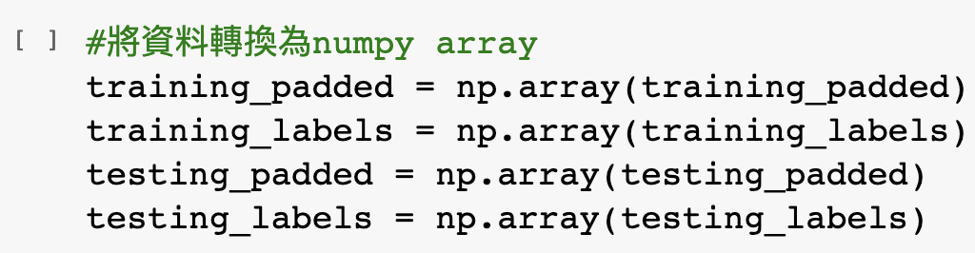
Transfer the Data to NumPy Array
Transfer all data to the NumPy array before training.
Since all parameters in TensorFlow are NumPy arrays, we should transfer our data as well.
Simply, just call np.array() to transfer your data.

Slide 38
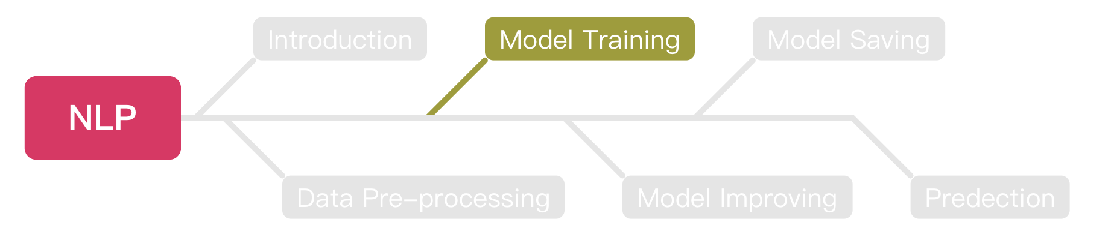
Outline

Slide 39
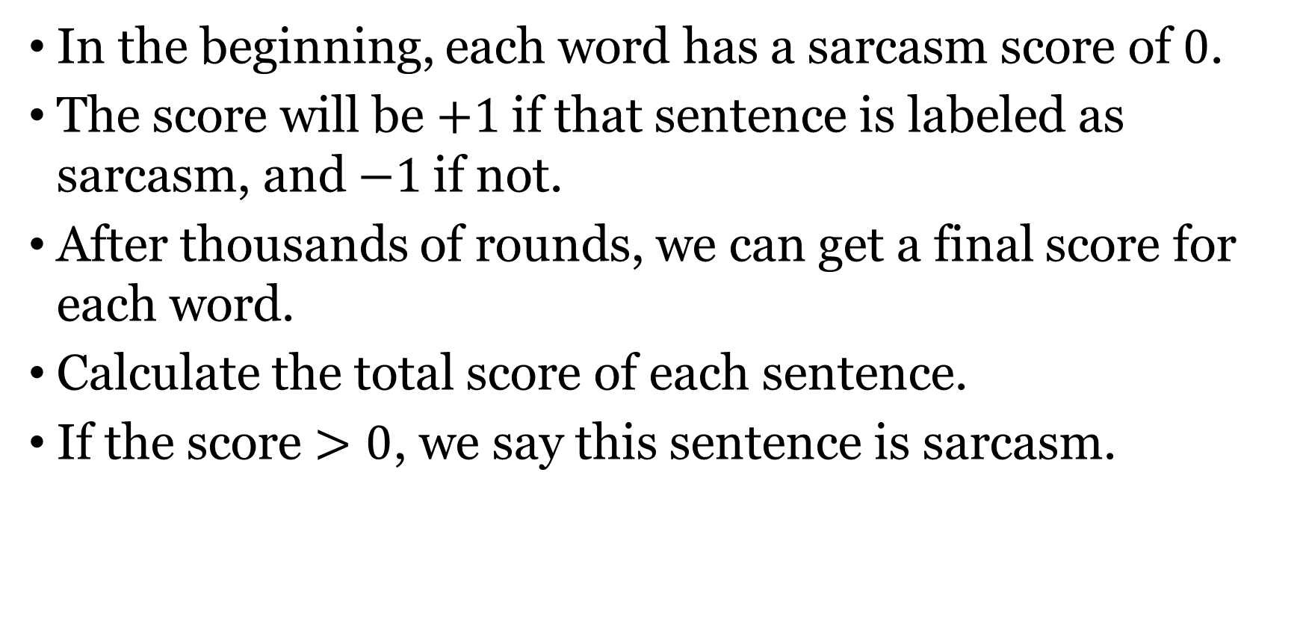
Embedding
In the beginning, each word has a sarcasm score of $0$.
The score will be $+1$if that sentence is labeled as sarcasm, and $−1$if not.
After thousands of rounds, we can get a final score for each word.
Calculate the total score of each sentence.
If the score $>0$, we say this sentence is sarcasm.

Slide 40
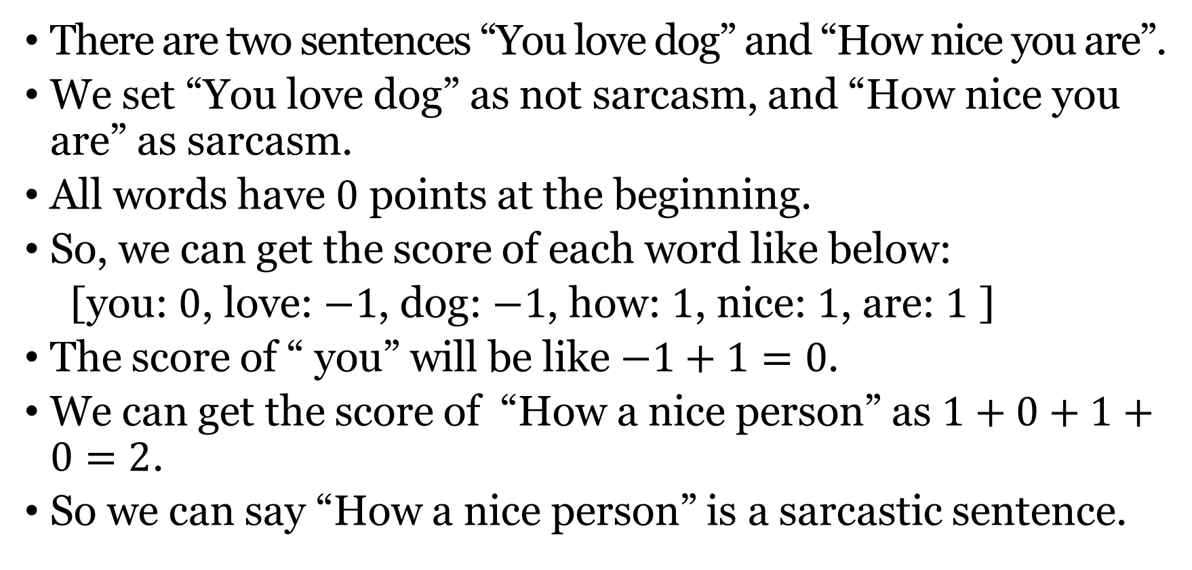
Embedding (Cont’d)
There are two sentences “You love dog” and “How nice you are”.
We set “You love dog” as not sarcasm, and “How nice you are” as sarcasm.
All words have $0$ points at the beginning.
So, we can get the score of each word like below:
[you: $0$, love: $−1$, dog: $−1$, how: $1$, nice: $1$, are: $1$ ]
The score of “ you” will be like $−1+1=0$.
We can get the score of “How a nice person” as $1+0+1+0=2$.
So we can say “How a nice person” is a sarcastic sentence.

Slide 41
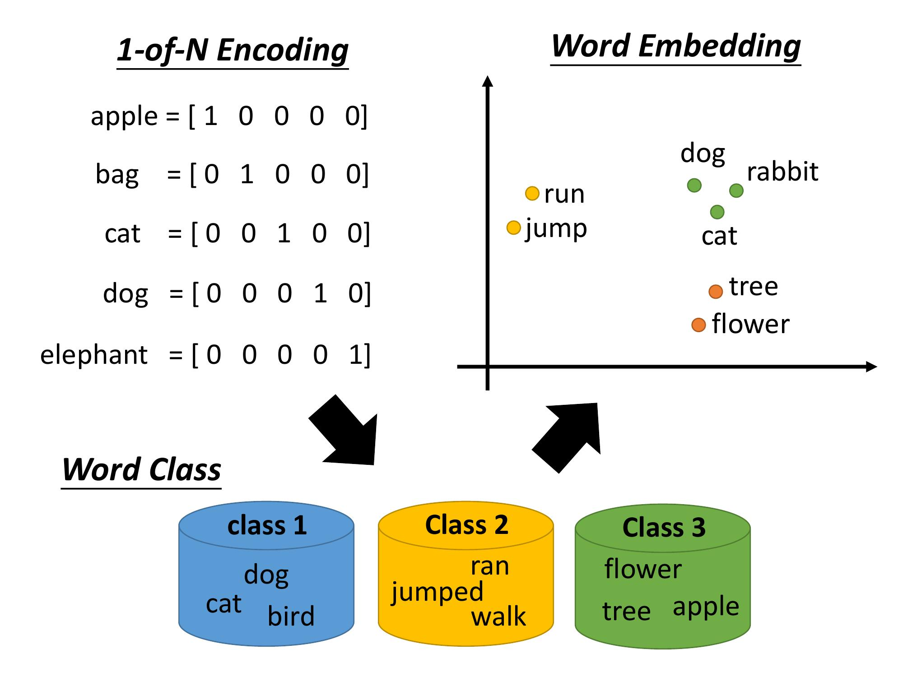


Embedding (Cont’d)
After embedding, we can get the vector of each word.
https://ai.ntu.edu.tw/resource/handouts/ML14.html

Slide 42
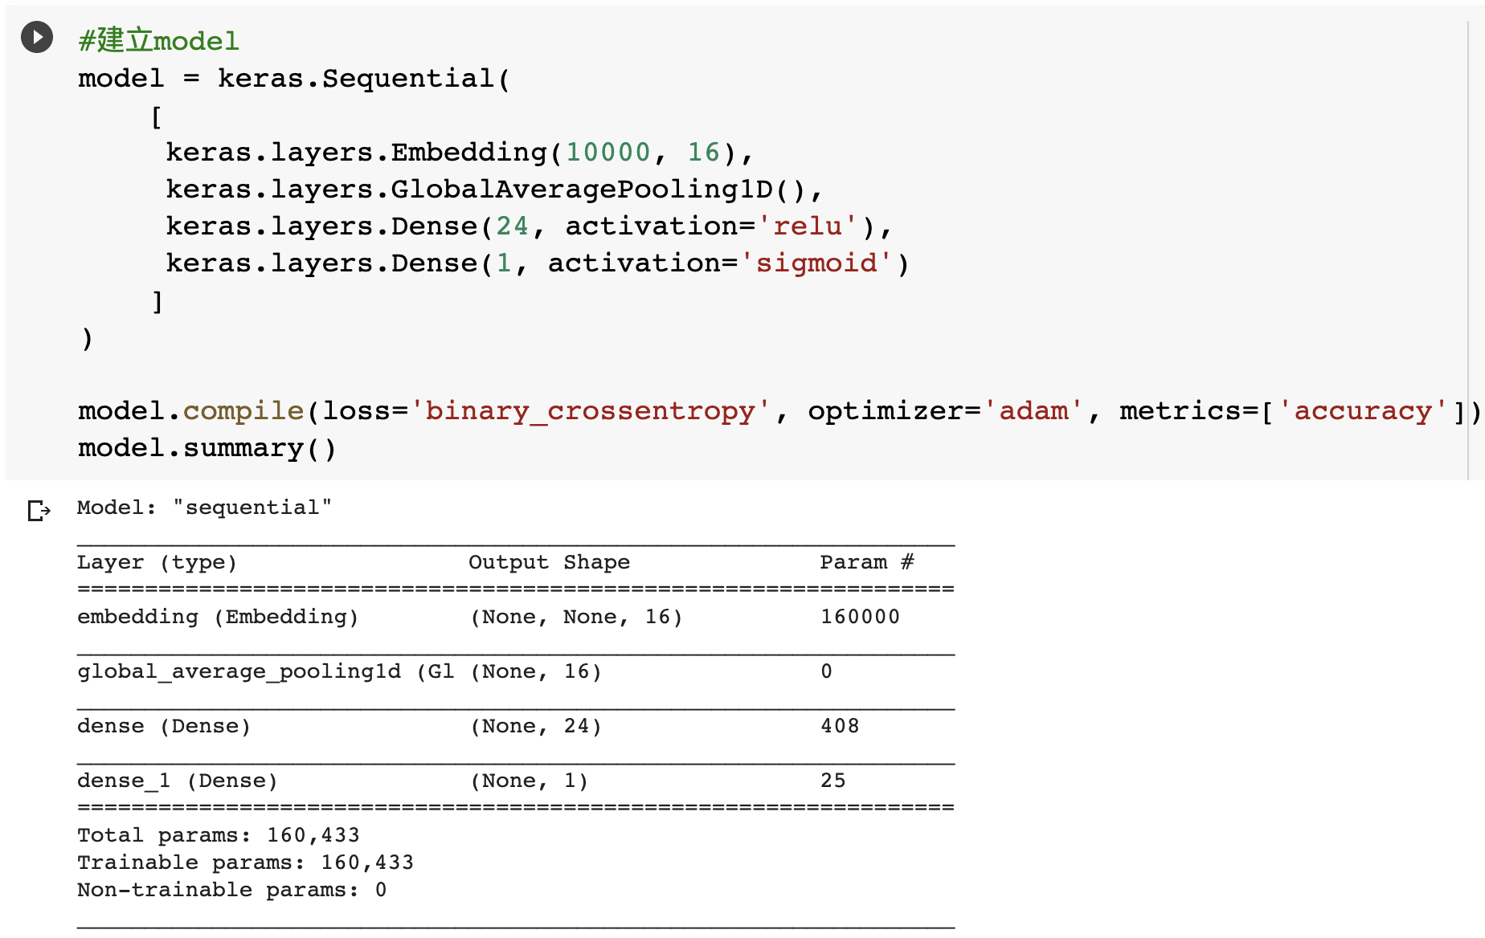
Build the Model

Slide 43
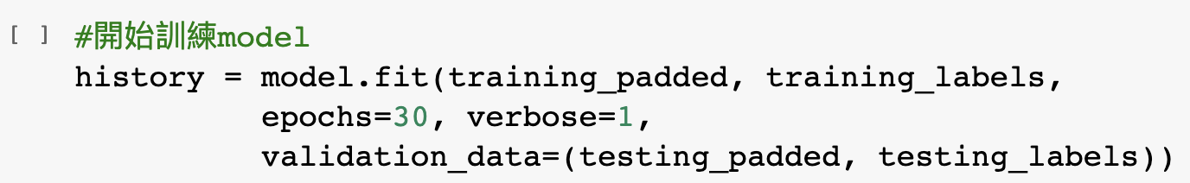
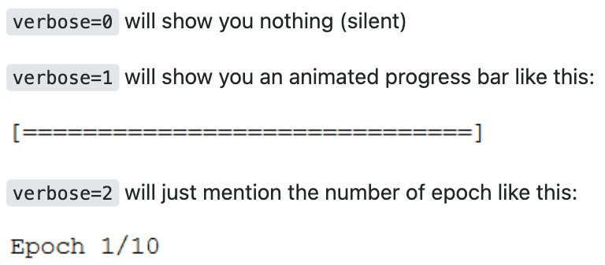
Train the Model
https://stackoverflow.com/questions/47902295/what-is-the-use-of-verbose-in-keras-while-validating-the-model

Slide 44
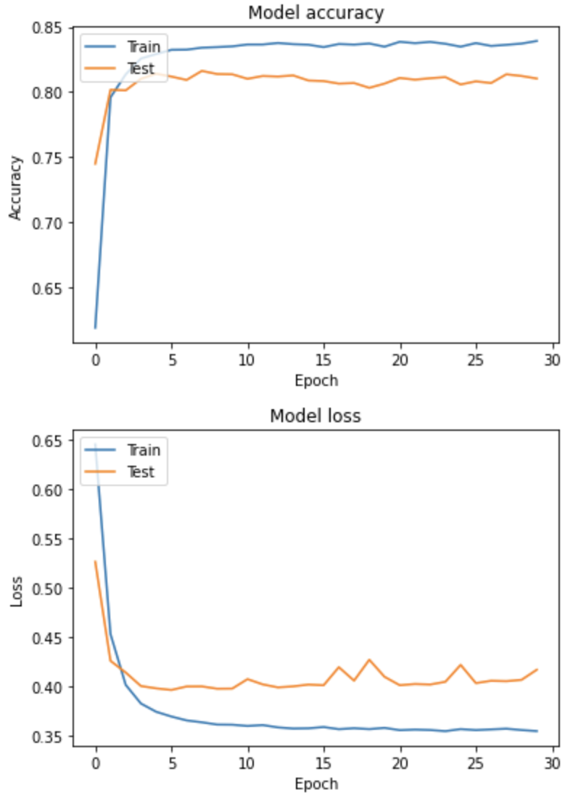
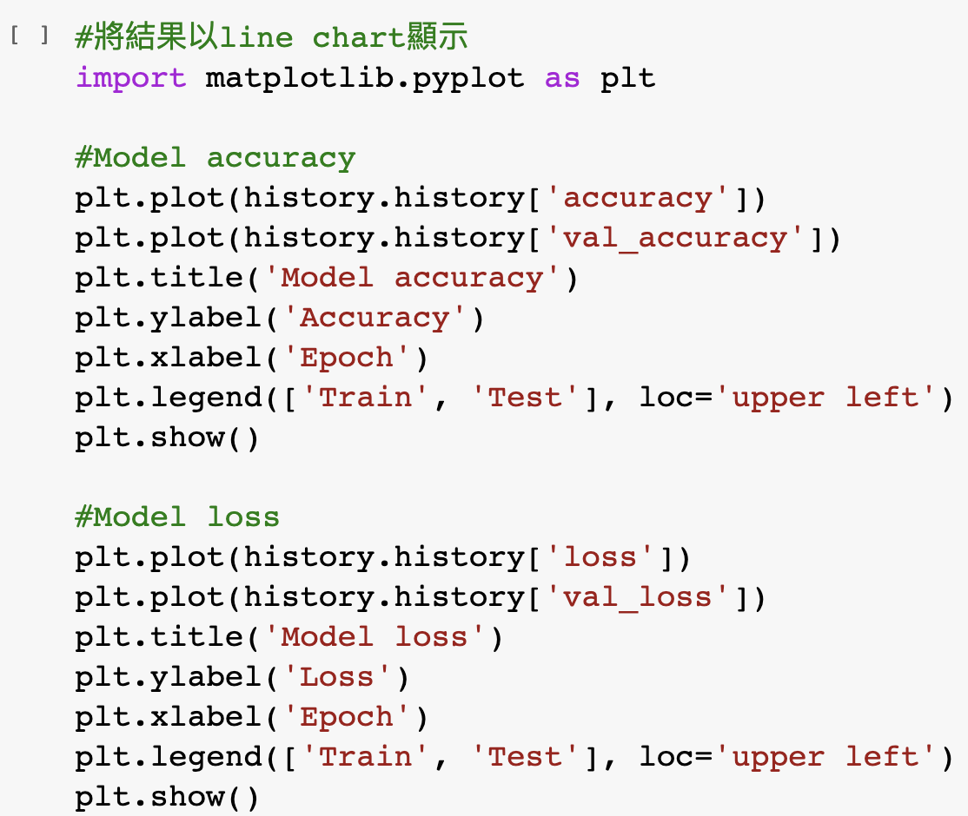
Plot the Results

Slide 45
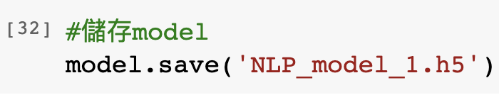
Save the Model
Save our trained model so that we don’t need to re-train it the next time.

Slide 46
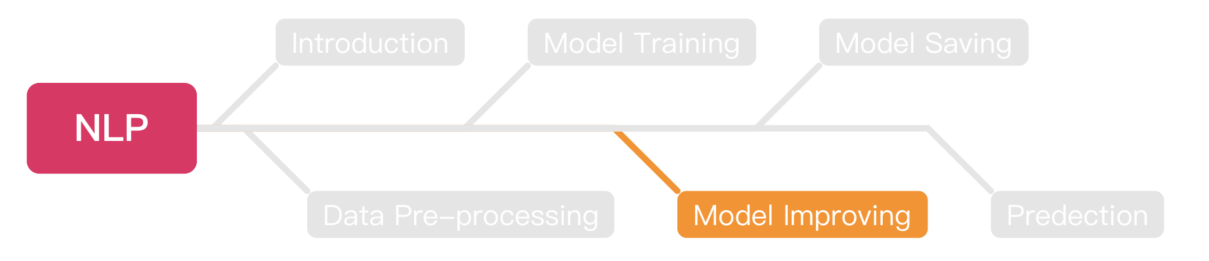
Outline

Slide 47
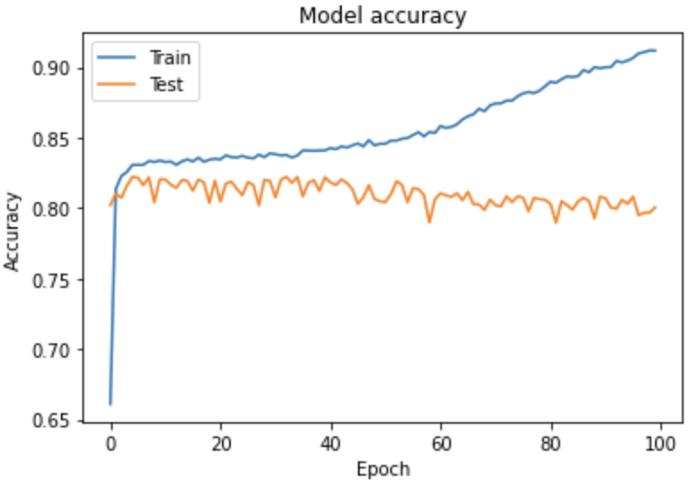
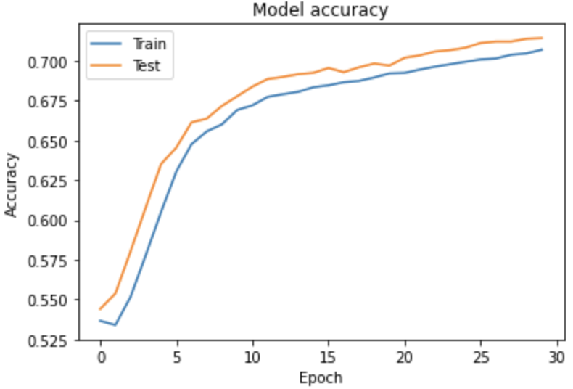
Before Model Improving
We should know these two different statuses before the model improves.
Overfitting
Underfitting

Slide 48
Overfitting
Overfitting is a problem that will happen during training your model.
The train accuracy gets higher but the validate accuracy remain the same or even lower.
Try to imagine if your model just memorizes all the answers, how it will be if the question in test set has a little bit change?

Slide 49
Underfitting
Underfitting means your model can do better.
If you stop training when your model is growing, that will cause underfitting.
You should increase the epochs or the number of layers to exploit the model to avoid underfitting.

Slide 50
Improving Our Model
After we know how to train our model, next step is to improve it.
We will try these ways to improve our model:
Increase the training epochs.
Add more hidden layers.
Use another NN for training.
Increase the amounts of data.
Improve the optimizer.

Slide 51
Improving Model
Increase the training epochs.
Add more hidden layers.
Use another NN for training.
Increase the amounts of data.
Improve the optimizer.

Slide 52
Build the Model

Slide 53


Improve the Epochs
The simplest way to try is to improve the training epochs.
For example, increase the epochs from $30$ to $100$.

Slide 54

Plot the Results

Slide 55

Save the Model
Save our trained model so that we don’t need to re-train it the next time.

Slide 56
Improving Model
Increase the training epochs.
Add more hidden layers.
Use another NN for training.
Increase the amounts of data.
Improve the optimizer.

Slide 57

Train with More Hidden Layers

Slide 58

Train with More Hidden Layers (Cont’d)
Train this model with $30$ epochs.

Slide 59


Plot the Result

Slide 60

Save the Model
Save our trained model so that we don’t need to re-train it the next time.

Slide 61
Improving Model
Increase the training epochs.
Add more hidden layers.
Use another NN for training.
Increase the amounts of data.
Improve the optimizer.

Slide 62

Recurrent Neural Network (RNN)
RNN stands for a recurrent NN.
RNN is one of the popular NN models, the characteristic is that RNN will re-train the model with new data.
https://www.researchgate.net/figure/The-standard-RNN-and-unfolded-RNN_fig1_318332317

Slide 63

Long Short Term Memory (LSTM)
LSTM is the most popular implementation of RNN.
The simple way to understand LSTM is:
It will re-train the data with new data.
It will dropout the data that is not important.
It has a gate to determine if the data can be output to the next layer.
https://www.rs-online.com/designspark/lstm-cn

Slide 64

Train Model with LSTM
We can use the build-in LSTM layer of Keras to train our model.

Slide 65


Train Model with LSTM (Cont’d)
Train the model with $30$ epochs.

Slide 66



Plot the Results

Slide 67

Save the Model
Save our trained model so that we don’t need to re-train it the next time.

Slide 68
Improving Model
Increase the training epochs.
Add more hidden layers.
Use another NN for training.
Increase the amounts of data.
Improve the optimizer.

Slide 69

Train with More Data
Since the data we have is not enough.
We should stand on the shoulders of giants.
Let’s use GloVe to train our model.
GloVe collects more than $2$ billion tweets on Twitter.
The dataset is more than $1.4$ GB!

Slide 70

Download GloVe Dataset
We can download the dataset with a simple Linux command.
Or, you can download it via this link.
https://huggingface.co/stanfordnlp/glove/resolve/main/glove.twitter.27B.zip

Slide 71

Unzip the Dataset
Python zipfile package can help you to zip or unzip files.
Always remember to close the file stream after finished.

Slide 72


Load the Data
Now, let’s try to load the data from the dataset.
We choose to use the glove.twitter.$27$B.$25$d.txt.
There are $27$ billion tokens and each token has $25$ dimensions.

Slide 73

Try to Print the Coefficients
After we loaded the data, we can try to print the coefficients.

Slide 74

Filter the Data
Since this dataset is too large, it will take lots of time for training.
We only take what we need.

Slide 75

Prepare the Model

Slide 76


Train the Model
Train the model with$30$epochs.

Slide 77



Plot the Results

Slide 78

Save the Model
Save our trained model so that we don’t need to re-train it the next time.

Slide 79
Improving Model
Increase the training epochs.
Add more hidden layers.
Use another NN for training.
Increase the amounts of data.
Improve the optimizer.

Slide 80

Optimizer
Don’t worry, we still have another way to enhance our trained model.
https://zhenglungwu.medium.com/pytorch-optimizers-03-adam-adamax-f8f53429dc1d

Slide 81

Optimizer (Cont’d)

Slide 82

Optimizer (Cont’d)
https://blog.paperspace.com/intro-to-optimization-momentum-rmsprop-adam/

Slide 83

Learning Rate
We can see if we should have an optimal learning rate.
It means we can’t let our model learn too fast or too low.
https://androidkt.com/change-learning-rate-in-the-pytorch-using-learning-rate-scheduler/

Slide 84

Results of 30 Epochs
Seems we got underfitting results.

Slide 85


Results of 50 Epochs

Slide 86


Results of 70 Epochs

Slide 87


Train the Model
Seems $50$ epochs is the best solution.
Please try to train this model with $50$ epochs.

Slide 88



Plot the Results.

Slide 89

Save the Model
Save our trained model so that we don’t need to re-train it the next time.

Slide 90

Outline

Slide 91


Save the Model
You can save your trained model for the next time prediction with these steps.
Download your model from Colab with this script.

Slide 92

Outline

Slide 93

Load Saved Model to Predict
You can load the local model with simple steps:
After loading, this model can be used to do prediction.

Slide 94


Pre-processing
We should do the same steps to the data we intended to predict as the training data.

Slide 95
Pre-processing (Cont’d)
Keep doing the pre-processing of our data.

Slide 96

Prediction
You can do the prediction with:
You can try to load other models we saved to see the results.

Slide 97
Exercise
We prepare two datasets for you to train your own model, both are stored as .csv files.
Of course, you can do the exact same method with us to build a workable model, but I am pretty sure it will be fascinating if you build your own one with different method.
Link to datasets: https://drive.google.com/drive/folders/1kwORuSfpuPlqKKLFc3rhT0nHusqA6EzF?usp=sharing

Slide 98

Download the Notebook
You can download what you done in Colab as .ipynb file.

Slide 99
Send Your Works
Please download the works you done as .ipynb file during the course.
After finishing the exercise, please also download it as .ipynb file.
Please send your works and exercise files to the mail: t110368151@ntut.org.tw
The title of the email should be in the following format: Student ID number_Name_NLP
The deadline for this exercise is 11/18/2022.

Slide 100
Bonus
The 3 top groups will get the bonus.
Please finished the exercise first, and then upload the model built by OnionOrNot.csv to google drive.
The title of the model should be in the following format: NLP_Group_XX.h5, e.g., NLP_Group_1.h5.
Link to google drive: https://drive.google.com/drive/folders/1JMkvny0Gb4AlP6uFlGmA2GSiT16NEX6u?usp=sharing

Slide 101
Thank you!

